Slide 1
CSC229 Machine Learning Algorithms & Programming
Part 2. Pattern Recognition
Peter Waiganjo Wagacha
2026

Slide 2
Human Perception
Humans have developed highly sophisticated skills for sensing their environment and taking actions according to what they observe, e.g.,
recognizing a face,
understanding spoken words,
reading handwriting,
distinguishing fresh food from its smell.
We would like to give similar capabilities to machines.
Source: Introduction to Pattern Recognition (slides), by Selim Aksoy

Slide 3
What is Pattern Recognition?
A pattern is an entity, vaguely defined, that could be given a name, e.g.,
fingerprint image,
handwritten word,
human face,
speech signal,
DNA sequence,
….
Pattern recognition is the study of how machines can
observe the environment,
learn to distinguish patterns of interest,
make sound and reasonable decisions about the categories of the patterns.
Notes:
Stop grp 1 Tue21feb

Slide 4
Pattern recognition
Pattern recognition has been defined as ‘the ability to abstract and integrate certain elements of a stimulus into an organized scheme for memory storage and retrieval’ (Solso,1998).
Recognition – is the process of establishing a close match between some new stimulus (signal) and previously stored stimulus.

Slide 5
Pattern recognition
Similar objects produce similar signals (stimulus) .
Class is a set of similar objects.
Patterns are collections of signals (stimulus) originating from similar objects.

Slide 6
Principles of Pattern Recognition
There are five principles (Solso,1998):
1.Quickly and accurately.
2.Recognise and classify unfamiliar objects.
3.Accurately recognize shapes and objects from different angles.
4.Identify patterns and objects even when partly hidden.
5.Recognise patterns quickly, with ease, and with automaticity.

Slide 7
Pattern recognition
Pattern recognition techniques are concerned with the theory and algorithms of putting abstract objects, e.g., measurements made on physical objects, into categories.
Typically the categories are assumed to be known in advance, although there are techniques to learn the categories (clustering).
Methods of pattern recognition are useful in many applications such as information retrieval, data mining, document image analysis and recognition, computational linguistics, forensics, biometrics and bioinformatics.

Slide 8
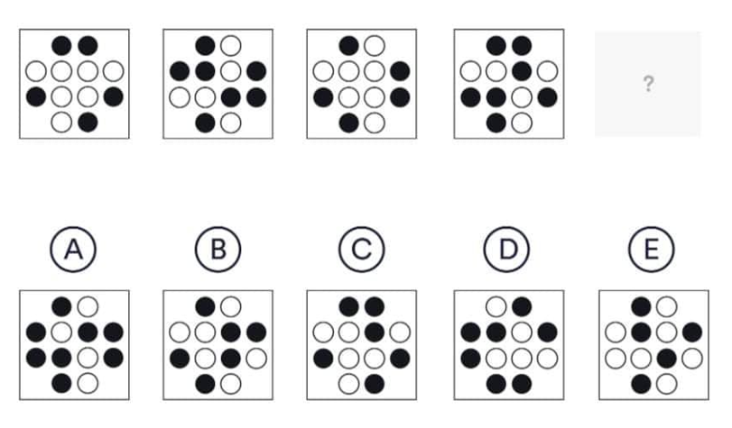
Which pattern is Next?
Source: Course Hero

Slide 9
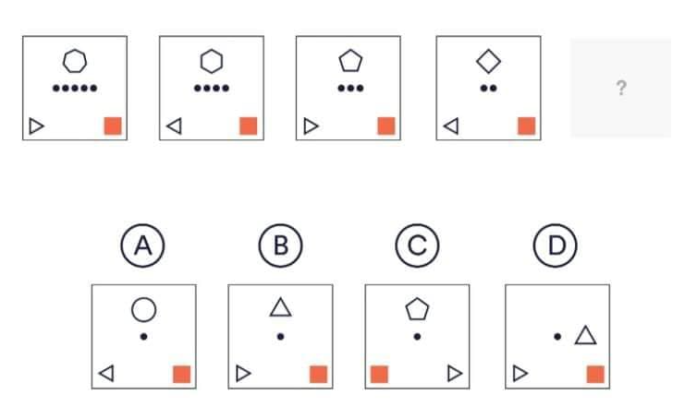
Which pattern is Next?
Source: Course Hero

Slide 10
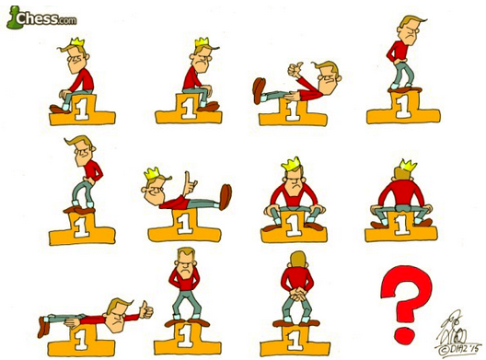
Which Next?

Slide 11
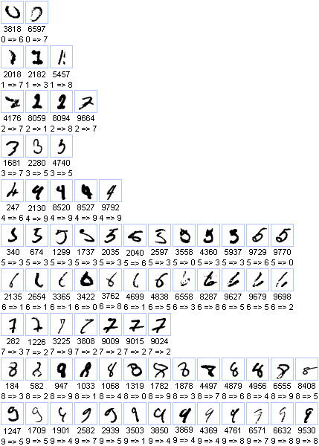
Hand-written Numbers

Slide 12


Weta

Slide 13
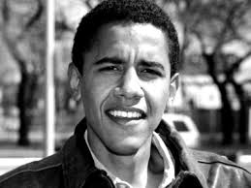
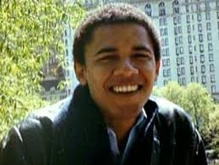
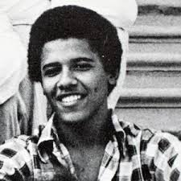
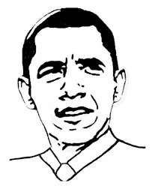
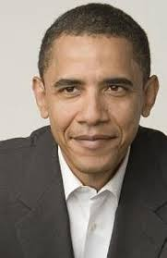
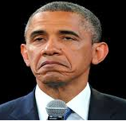
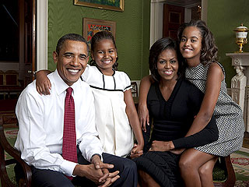
Obama

Slide 14
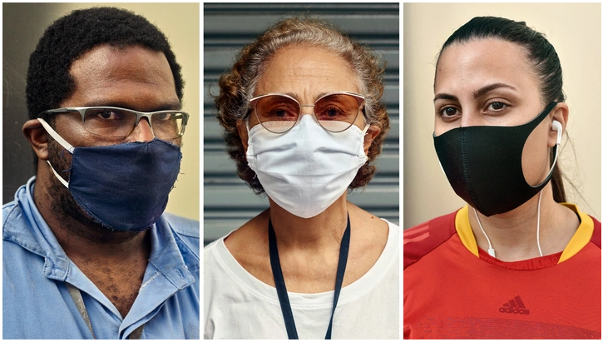
Recognition disrupted
Source: https://www.theatlantic.com/health/archive/2021/01/why-arent-we-wearing-better-masks/617656/

Slide 15
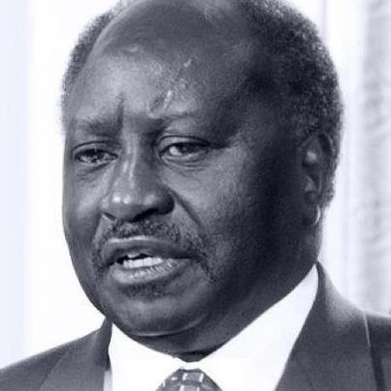
?
An example - photoshop

Slide 16
?

Slide 17
?

Slide 18
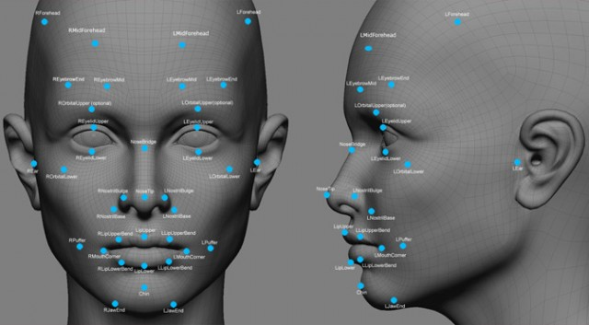
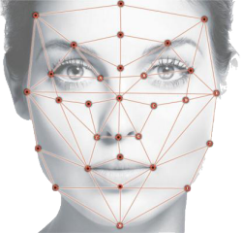

Slide 19
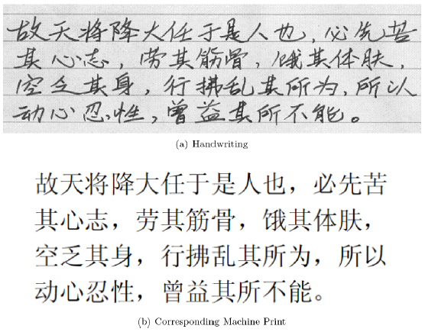
Chinese Characters

Slide 20
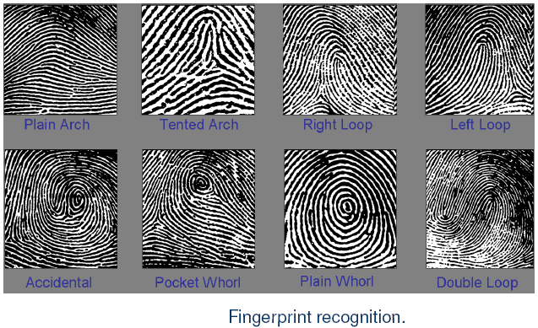
Unique patterns

Slide 21
Pattern Recognition Theories/Techniques
These depend on the domain and available data.
Template matching theories
Feature analysis
Statistical techniques
Syntactic techniques
Neural Network models
Fuzzy models

Slide 22
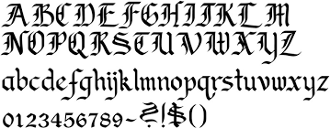
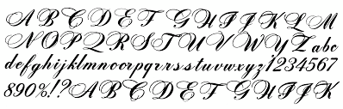
Template matching theories
External stimuli matches internal template
Vast numbers of templates are stored
Templates are created by experience
A
A
A
A

Slide 23
Feature Theory
Patterns are recognized by analysis of the individual features of the pattern.
Ex.: MANGO
M
A

Slide 24
Pattern Recognition
Objective of pattern recognition is classification
A pattern recognition system is three stage:
First stage – feature extraction
Second stage – matching /distance measure
Third stage - classification
Sensors
stimuli
Feature
extraction
Matching
Classification
Notes:
stopG2

Slide 25
Pattern Recognition
Feature: - a measurement taken on input pattern that is to be classified.
Classification: - mapping of input features into class categories by matching (measuring)
Classifiers typically rely on distance metrics and probability theory.

Slide 26
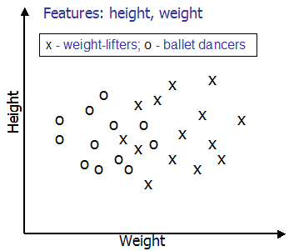
Features
Features are numerically expressed properties of an input signal (stimulus)
The set of features used for pattern recognition is called feature vector.
The number of features is the dimensionality of the feature vector.
n-dimensional feature vectors can be represented as points in n-dimension feature space.

Slide 27
Guidelines for features
Use as few as possible (reduce dimensionality of problem)
Use features that differentiate classes well (relevant)

Slide 28
Quick Task
You are provided with two groups of points:
Group A: (1,2); (2,2); (3,1); (2,3)
Group B: (5,6); (6,5); (4,6); (5,5)
In which group would you place new points:
(5,4); (3,5) and (4,4)

Slide 29
Distance between feature vectors
Instead of finding pattern exactly matching input pattern, look how close feature vectors are.
Nearest neighbour classification:
Class 1
Find object closest to the input pattern.
Classify pattern to the same class as closest object.
Class 2

Slide 30
Distance between feature vectors
Modification of nearest neighbor classifier: use k nearest neighbors instead of 1 to classify pattern. Nearest neighbour classification:
Class 1
Class 1
Class 2
Class 2

Slide 31
Clustering
Reduce the number of stored objects – keep only cluster centers.
Cluster A
Cluster B
Clustering algorithms reveal the structure of classes in feature space and are used in unsupervised training.

Slide 32
Pattern Recognition and Machines
Primary objective:
To give AI systems the ability to recognize and understand complicated patterns on their own, so they can do things like speech and image recognition, language translation, and predictive analysis.
Pattern recognition functions as a crucial process enabling AI systems to generalize from training data and make informed decisions when confronted with novel, unseen information.

Slide 33
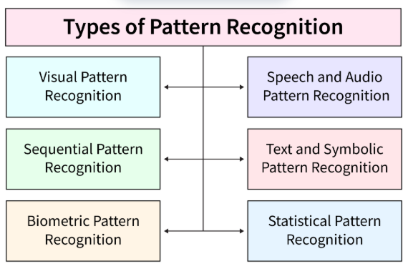
Types of Pattern Recognition
Source: https://www.scaler.com/

Slide 34
Example: Text and Symbolic Pattern Recognition
Word Embeddings: these are representations of words as vectors in a continuous space, are frequently used in text and symbolic pattern recognition applications. This makes it possible for machines to understand the meaning connections between words.
Sentiment Analysis: Uses text pattern recognition to identify the sentiment conveyed in textual content, like social media posts or customer evaluations.
Named Entity Recognition (NER): is a text pattern recognition task that entails locating and categorizing entities in a text, such as names of individuals, places, or organizations.
Language Translation: In order for systems to comprehend the syntactic and semantic structures of sentences in other languages, pattern recognition is essential in language translation jobs.
Document Classification: Text pattern recognition is used in document processing to categorize documents into pre-established groups, making information retrieval and organization more effective.
Topic Modeling: For topic modeling in text data, methods like as Latent Dirichlet Allocation (LDA) are employed to find underlying themes or topics in a set of texts.

Slide 35
Example: Biometric Pattern Recognition
Fingerprint Recognition: this involves identification of unique patterns in the ridges and valleys of fingerprints. A widely used biometric technique in secure access and identification.
Iris Recognition: Iris identification depends on the distinct patterns found in the eye's iris. It is utilized in applications needing strict security measures and is renowned for its great precision.
Voice Authentication: In speech authentication, biometric pattern recognition examines vocal traits to identify users, providing a practical and safe way to manage access.
Gait Recognition: Analyzing each person's distinct gait is part of gait recognition. There are uses for this biometric modality in security and surveillance systems.
Behavioural Biometrics: Additional levels of security in authentication are provided by biometric pattern recognition, which also extends to behavioral characteristics like keystroke dynamics or signature analysis.
Multi-Modal Biometrics: Combining different biometric modalities, such fingerprint and face recognition, improves identification systems' overall robustness and accuracy.

Slide 36
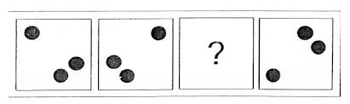
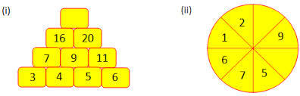
Complete the pattern

Slide 37
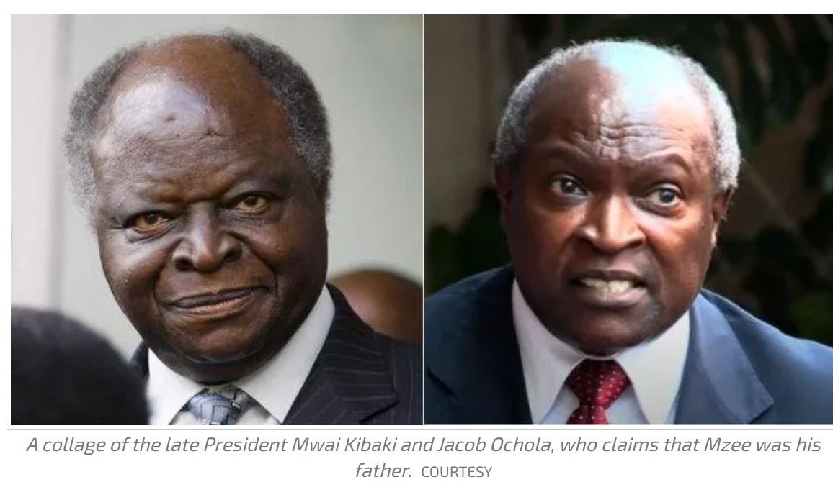
Task: Find the Pattern(s)
According to human pathology by Dr Thaimuta, Ocholla's resemblance to Kenya’s third President is not an ordinary coincidence. After analysis of the anatomical features of both Kibaki and Ocholla, Thaimuta made observations which he placed before the Judge.
“The following items are distinctly identifiable: The craniofacial features and morphology of nose, forehead, eyelids and lips resemble. "The cheeks and cheekbone are similar. Sustained eye contact and eye blinking are similar. The baldness between the compared photos is similar. Speech and lips movement (also show) similarity,”
Source: https://www.kenyans.co.ke/news/86330-why-jacob-ocholla-resembles-mwai-kibaki-expert-compiles-medical-report Date:1st March 2023

